Slide 1









My Number
Interactive Notebook
$$×$$
$$\frac{1}{2}$$
$$÷$$
$$+$$
$$−$$
$$\frac{3}{5}$$
$$7$$
Name
Class
Teacher
Term 1 Semester 1
$$5^{2}$$
$$\sqrt{9}$$
1

Slide 2
Contents
Glossary or Formula Page
Page
Date
Description
2
3

Slide 3
Tasks
24
7
30
Essential Question
Questions
Notes
Summary
6
7

Slide 4
24
7
30
Date
Factors
EQ – How do I find the HCF of two numbers?

Slide 5
24
7
30
Date
Factors
EQ – How do I find the HCF of two numbers?
What is a factor?

Slide 6
24
7
30
Date
Factors
EQ – How do I find the HCF of two numbers?
What is a factor?
The numbers that divide exactly into another number with no remainder.

Slide 7
24
7
30
Date
Factors
EQ – How do I find the HCF of two numbers?
What is a factor?
The numbers that divide exactly into another number with no remainder.
How do I find the factors of a number?

Slide 8
24
7
30
Date
Factors
EQ – How do I find the HCF of two numbers?
What is a factor?
The numbers that divide exactly into another number with no remainder.
How do I find the factors of a 15?
Find the numbers that multiply to give 15.

Slide 9

24
7
30
Date
Factors
EQ – How do I find the HCF of two numbers?
What is a factor?
The numbers that divide exactly into another number with no remainder.
How do I find the factors of a 15?
Find the numbers that multiply to give 15.
$$1×15$$
$$3×5$$

Slide 10
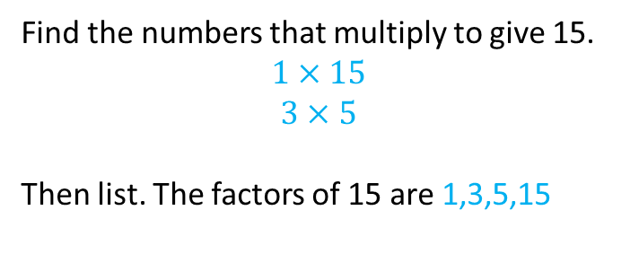
24
7
30
Date
Factors
EQ – How do I find the HCF of two numbers?
What is a factor?
The numbers that divide exactly into another number with no remainder.
How do I find the factors of a 15?
Find the numbers that multiply to give 15.
$$1×15$$
$$3×5$$
Then list. The factors of 15 are 1,3,5,15

Slide 11
24
7
30
Date
Factors
EQ – How do I find the HCF of two numbers?
What is a factor?
The numbers that divide exactly into another number with no remainder.
How do I find the factors of a 15?
Find the numbers that multiply to give 15.
$$1×15$$
$$3×5$$
Then list. The factors of 15 are 1,3,5,15
What is the HCF?

Slide 12
24
7
30
Date
Factors
EQ – How do I find the HCF of two numbers?
What is a factor?
The numbers that divide exactly into another number with no remainder.
How do I find the factors of a 15?
Find the numbers that multiply to give 15.
$$1×15$$
$$3×5$$
Then list. The factors of 15 are 1,3,5,15
What is the HCF?
Highest Common factor
How do I find the HCF of two numbers?

Slide 13
24
7
30
Date
Factors
EQ – How do I find the HCF of two numbers?
What is a factor?
The numbers that divide exactly into another number with no remainder.
How do I find the factors of a 15?
Find the numbers that multiply to give 15.
$$1×15$$
$$3×5$$
Then list. The factors of 15 are 1,3,5,15
What is the HCF?
Highest Common factor
How do I find the HCF of two numbers?
List the factors of both numbers.
Then find the highest number in both lists.

Slide 14
24
7
30
Date
Factors
EQ – How do I find the HCF of two numbers?
What is a factor?
The numbers that divide exactly into another number with no remainder.
How do I find the factors of a 15?
Find the numbers that multiply to give 15.
$$1×15$$
$$3×5$$
Then list. The factors of 15 are 1,3,5,15
What is the HCF?
Highest Common factor
How do I find the HCF of two numbers?
List the factors of both numbers.
Then find the highest number in both lists.
Example
Find the HCF of 8 and 20

Slide 15
24
7
30
Date
Factors
EQ – How do I find the HCF of two numbers?
What is a factor?
The numbers that divide exactly into another number with no remainder.
How do I find the factors of a 15?
Find the numbers that multiply to give 15.
$$1×15$$
$$3×5$$
Then list. The factors of 15 are 1,3,5,15
What is the HCF?
Highest Common factor
How do I find the HCF of two numbers?
List the factors of both numbers.
Then find the highest number in both lists.
Find the HCF of 8 and 20
Factors of 8 – 1, 2, 4, 8
Factors of 20 -1, 2, 4, 5, 10, 20
Example

Slide 16
24
7
30
Date
Factors
EQ – How do I find the HCF of two numbers?
What is a factor?
The numbers that divide exactly into another number with no remainder.
How do I find the factors of a 15?
Find the numbers that multiply to give 15.
$$1×15$$
$$3×5$$
Then list. The factors of 15 are 1,3,5,15
What is the HCF?
Highest Common factor
How do I find the HCF of two numbers?
List the factors of both numbers.
Then find the highest number in both lists.
Find the HCF of 8 and 20
Factors of 8 – 1, 2, 4, 8
Factors of 20 -1, 2, 4, 5, 10, 20
Example

Slide 17
24
7
30
Date
Factors
EQ – How do I find the HCF of two numbers?
What is a factor?
The numbers that divide exactly into another number with no remainder.
How do I find the factors of a 15?
Find the numbers that multiply to give 15.
$$1×15$$
$$3×5$$
Then list. The factors of 15 are 1,3,5,15
What is the HCF?
Highest Common factor
How do I find the HCF of two numbers?
List the factors of both numbers.
Then find the highest number in both lists.
Find the HCF of 8 and 20
Factors of 8 – 1, 2, 4, 8
Factors of 20 -1, 2, 4, 5, 10, 20
So the HCF of 8 and 20 is 4
Example

Slide 18
Your turn
  a) Write down the factors of 12
b) Write down the factors of 18
c) Find the HCF off 12 and 18

Slide 19
Nelson text page 82
Questions 3-5

Slide 20
Notes Review
24, 7 ,30
Date
Title
Essential question
Notes complete
Notes complete with colour and diagrams
Questions completed
Contents page filed in
Formula page filled in

Slide 21
Homework
Review your notes and write a summary answering the essential question.

